Slide 1
DATA MINING
CSE -4229
Md. Manowarul Islam
Lecturer, Dept. of CSE
Jagannath University

Slide 2
The SPADE Algorithm
SPADE (Sequential PAttern Discovery using Equivalent Class) developed by Zaki 2001
A vertical format sequential pattern mining method
A sequence database is mapped to a large set of
  Item: <SID, EID>
Sequential pattern mining is performed by
  growing the subsequences (patterns) one item at a time by Apriori candidate generation

Slide 3
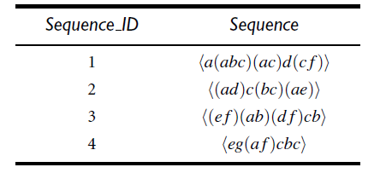
The SPADE Algorithm
A sequence database is mapped to a large set of Item
  Item: <SID, EID>
  SID= Sequence ID
  EID= Event ID
SID | EID | Item/items
1 | 1 | a
1 | 2 | abc
1 | 3 | ac
1 | 4 | d
1 | 5 | cf

Slide 4
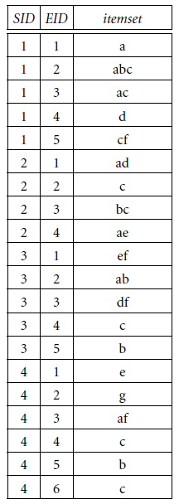
Example
ID list for 1-sequence
a
SID | EID
1 | 1
1 | 2
1 | 3
2 | 1
3 | 2
4 | 3
frequent because it contains in 4 sequence

Slide 5
Example
ID list for 1-sequence
b
SID | EID
1 | 2
2 | 3
3 | 2
3 | 5
4 | 5
frequent because it contains in 4 sequence

Slide 6
To find candidate 2-sequences, we join all pairs of single items if they are frequent
  if they share the same sequence identifier
  if their event identifiers follow a sequential ordering.
  For example consider 2 items, x and y.
  They will be joined if
    SID(x)=SID(y)
    EID(x)<EID(y)
It shows, both x and y occur in same sequence and that x occurs before y.

Slide 7
Example
ID list for 2-sequence
a
SID | EID
1 | 1
1 | 2
1 | 3
2 | 1
3 | 2
4 | 3
b
SID | EID
1 | 2
2 | 3
3 | 2
3 | 5
4 | 5
ab
SID | EID(a) | EID(b)
1 | 1 | 2

Slide 8
Example
ID list for 2-sequence
a
SID | EID
1 | 1
1 | 2
1 | 3
2 | 1
3 | 2
4 | 3
b
SID | EID
1 | 2
2 | 3
3 | 2
3 | 5
4 | 5
ab
SID | EID(a) | EID(b)
1 | 1 | 2
X

Slide 9
Example
ID list for 2-sequence
a
SID | EID
1 | 1
1 | 2
1 | 3
2 | 1
3 | 2
4 | 3
b
SID | EID
1 | 2
2 | 3
3 | 2
3 | 5
4 | 5
ab
SID | EID(a) | EID(b)
1 | 1 | 2
X

Slide 10
Example
ID list for 2-sequence
a
SID | EID
1 | 1
1 | 2
1 | 3
2 | 1
3 | 2
4 | 3
b
SID | EID
1 | 2
2 | 3
3 | 2
3 | 5
4 | 5
ab
SID | EID(a) | EID(b)
1 | 1 | 2
X
X
X

Slide 11
Example
ID list for 2-sequence
a
SID | EID
1 | 1
1 | 2
1 | 3
2 | 1
3 | 2
4 | 3
b
SID | EID
1 | 2
2 | 3
3 | 2
3 | 5
4 | 5
ab
SID | EID(a) | EID(b)
1 | 1 | 2
2 | 1 | 3
3 | 2 | 5
4 | 3 | 5

Slide 12
Example
ID list for 2-sequence
b
SID | EID
1 | 2
2 | 3
3 | 2
3 | 5
4 | 5
a
SID | EID
1 | 1
1 | 2
1 | 3
2 | 1
3 | 2
4 | 3
ba
SID | EID(a) | EID(b)
1 | 2 | 3
2 | 3 | 4

Slide 13
Example
a
SID | EID
1 | 1
1 | 2
1 | 3
2 | 1
3 | 2
4 | 3
ba
SID | EID(a) | EID(b)
1 | 2 | 3
2 | 3 | 4
aba
SID | EID(a) | EID(b) | EID(b)
1 | 1 | 2 | 3
2 | 1 | 3 | 4
ID list for 3-sequence

Slide 14
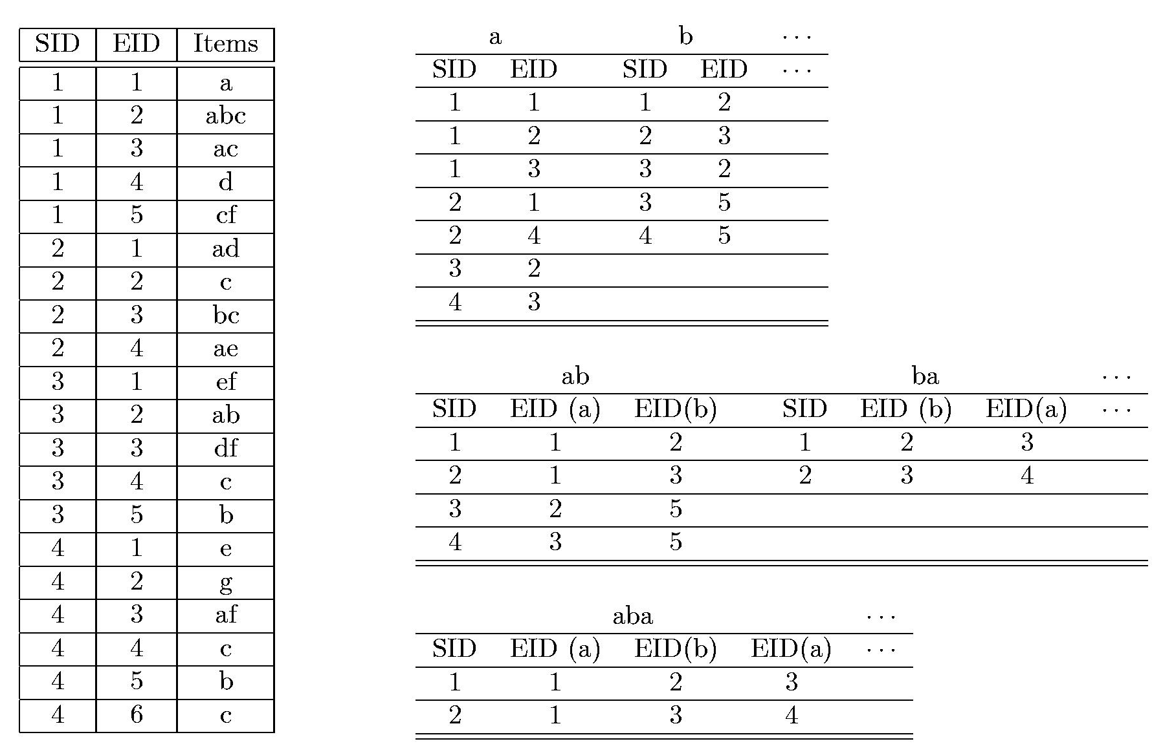
Don’t fear…..

Slide 15
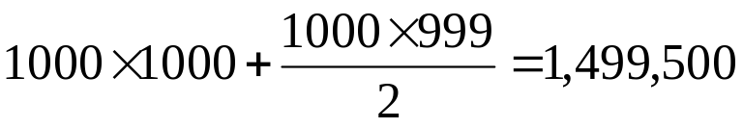
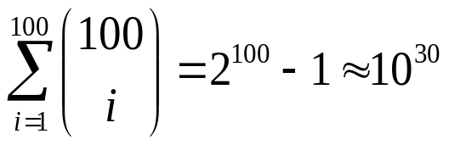
Bottlenecks of GSP and SPADE
A huge set of candidates could be generated
  1,000 frequent length-1 sequences generate s huge number of length-2 candidates!
Multiple scans of database in mining
Breadth-first search
Mining long sequential patterns
  Needs an exponential number of short candidates
  A length-100 sequential pattern needs 10³⁰ candidate sequences!

Slide 16
Thank you

